Slide 1

Elements of computing – assignment 6
Batch b - group 15

Slide 2
Question 1 Write a Jack program TO perform MERGE sort using recursion

Slide 3
answer
Merge sort is a function that takes an array as input and recursively divides it into smaller halves until the base case is reached(when the
array size is 1 or less). Then, the merge function is used to merge the sorted halves back together to form the final sorted array.
Finally, the sorted array is returned.

Slide 4
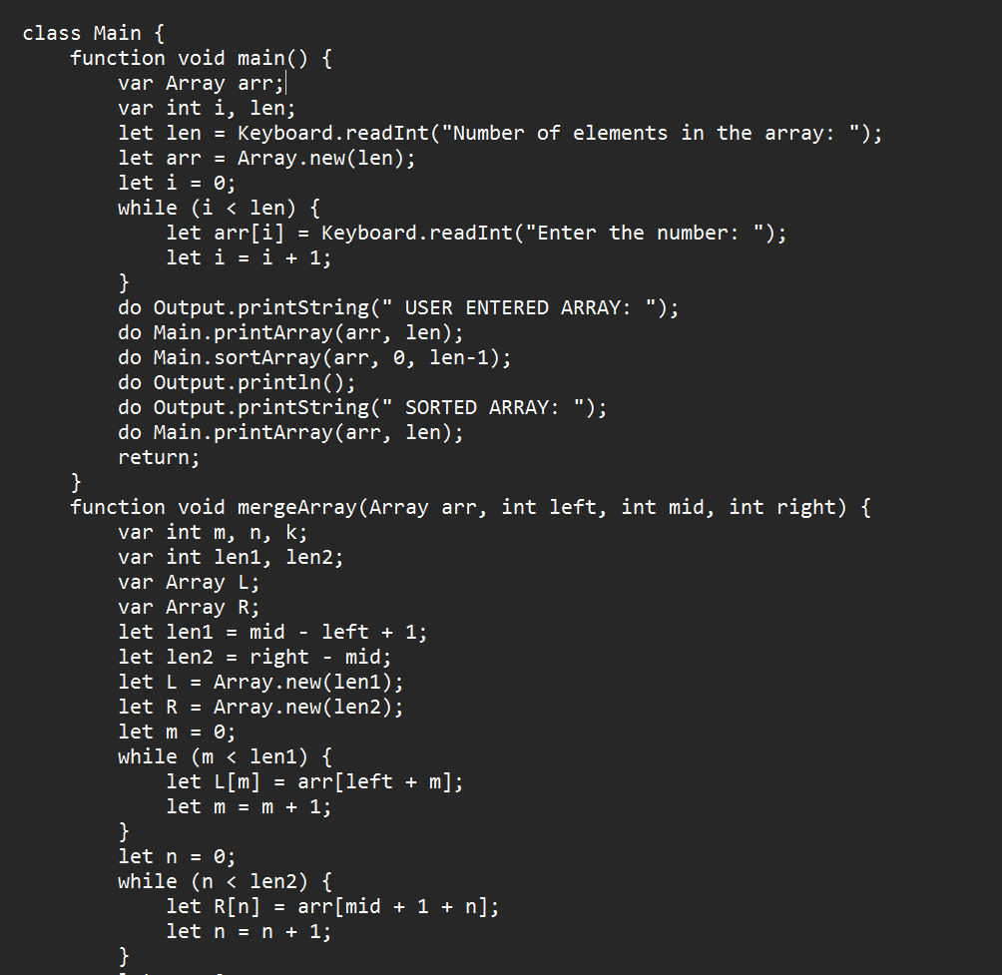
Code explanation
We start by initializing an array named arr of length len, taking the array's values from the user, and then displaying the created array. After this, we call the sortArray function to sort the array using the Merge Sort algorithm. The sortArray function takes the array arr, the left index 0, and the right index len - 1 as parameters.
Inside the sortArray function, we calculate the middle index mid as the average of the left and right indices. We then recursively call the sortArray function for the left and right halves of the array, followed by
calling the mergeArray function.

Slide 5
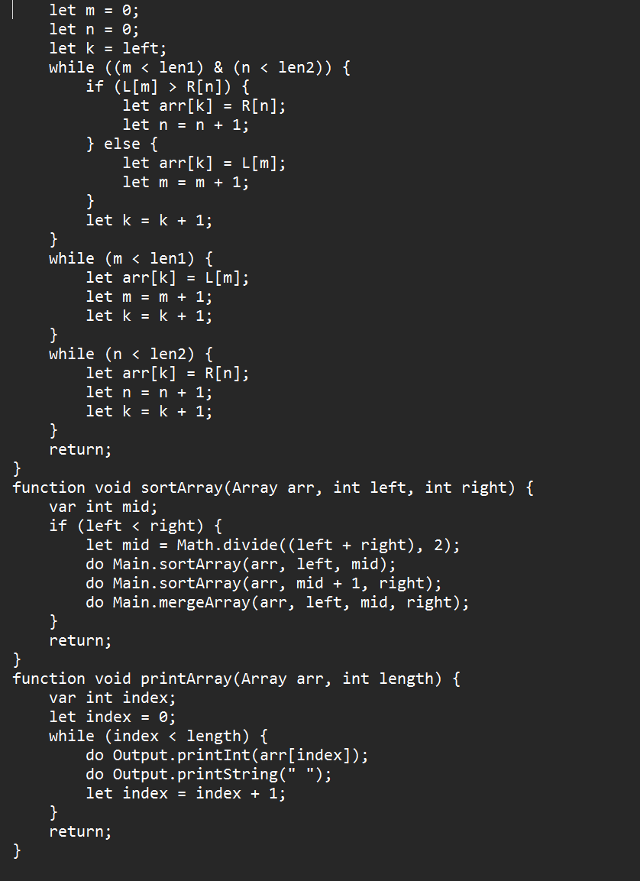
Code explanation
The mergeArray function takes the array arr, left index left, middle index mid, and right index right as parameters. It merges the two sorted halves of the array into a new sorted array.
To accomplish this, we create temporary arrays L and R to store the elements of the left and right halves, respectively. We copy the corresponding elements from the original array arr to these temporary arrays.
Then, using index variables m, n, and k, we compare the elements from L and R and merge them back into the original array arr in sorted order.
After merging the elements, the function returns, and the sorted array is obtained.
Finally, we call the printArray function to print the sorted array.

Slide 6
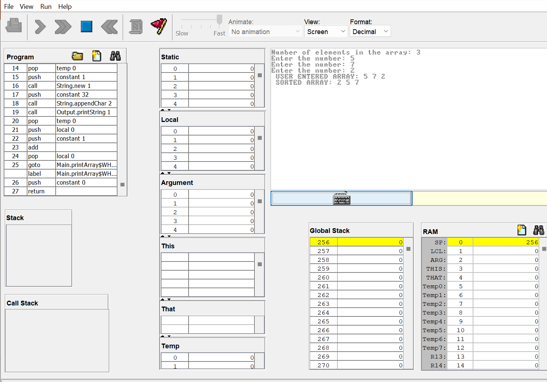
Execution in vm emulator

Slide 7
Question 2 Write a Jack program to perform BINARY search

Slide 8
answer
Binary Search is a searching algorithm that can only be used on sorted arrays. First, we take the lower and upper indexes of the array. At the start, it will be ‘0’ and the length of the array – 1. It works by finding the middle element in the array and then checking if that element is greater, lesser, or equal to our target element. If it is equal, it stops and returns the index. But if it is greater or lesser than our target element, we reduce our search area in half and find the corresponding middle element again. This goes on until we find our target element or the upper and lower indexes become equal in which case the element does not exist in the array.
The algorithm takes advantage of the fact that the array is already sorted, reducing the time complexity to O(log n).

Slide 9
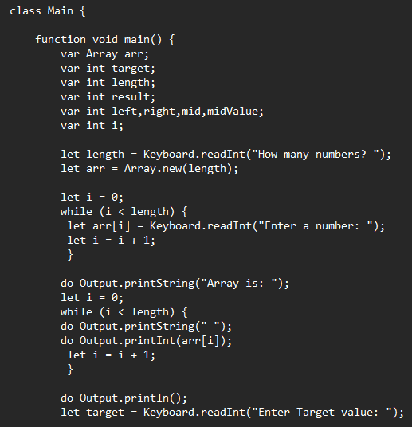
Code explanation
We start by initializing an array named ‘arr’ of length ‘length’, taking the array's values from the user, and then displaying the created array. After this, we also take the value of the target element from the user and store it in variable ‘target’.

Slide 10
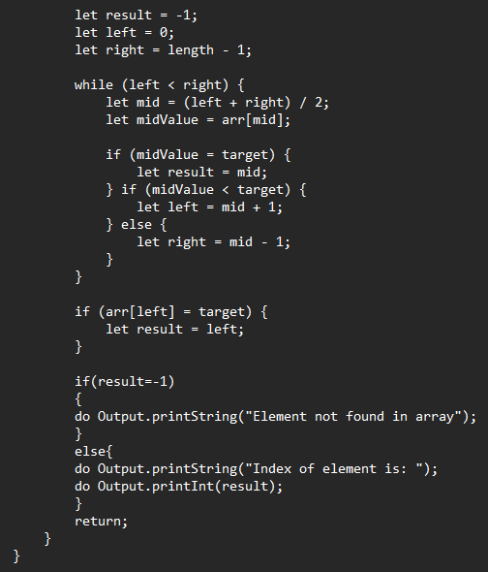
Code explanation
Initializing the ‘result’ variable as -1 in case the element is not found.
Also, ‘left’ = 0 and ‘right’ = length – 1.
Then we start a loop that runs as long as variable ‘left’ is less than variable ‘right’.
Inside the loop, it first checks if the middle element is equal to our target value. If it is, the corresponding index is stored inside the ‘result’ variable.
If the target value is less than the middle element of the array, we narrow down our search area to the first half of the array by changing the value of the ‘right’ variable. If the target value is greater than the middle element of the array, we narrow down our search area to the second half of the array by changing the value of the ‘left’ variable.
This cycle continues until values in ‘left’ and ‘right’ variable become equal.
After the loop, if the element is found, the ‘result’ variable will contain the index of the element, or else it will contain ‘-1’.

Slide 11
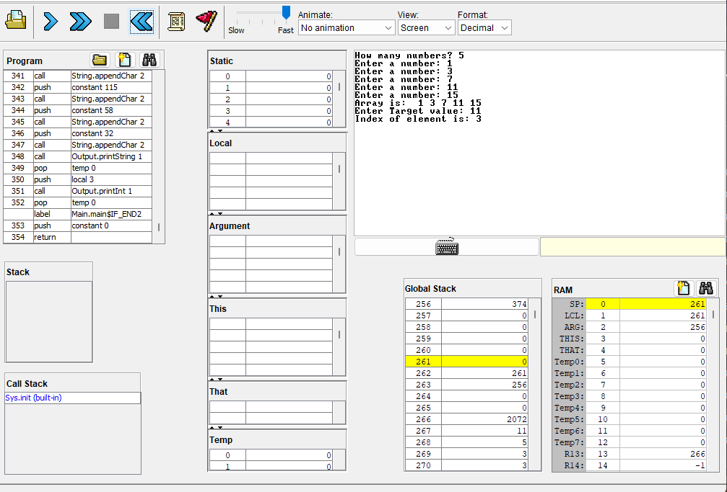
Execution in vm emulator

Slide 12
Question 3 Write a Jack to VM-Compiler in Python or Java, conforming to the ‘Standard VM-on-Hack Mapping’. Use your Compiler to translate the above .jack programs to .vm programs.

Slide 13
Answer
We implemented this compiler in Python. It has 5 Python files namely, compile.py, engine.py, generator.py, symboltable.py, and tokenizer.py.
Screenshots of the code and the final output are included. Detailed explanation about the code in the report.

Slide 14
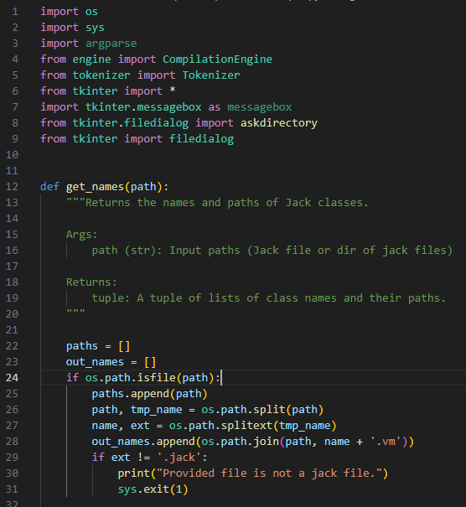
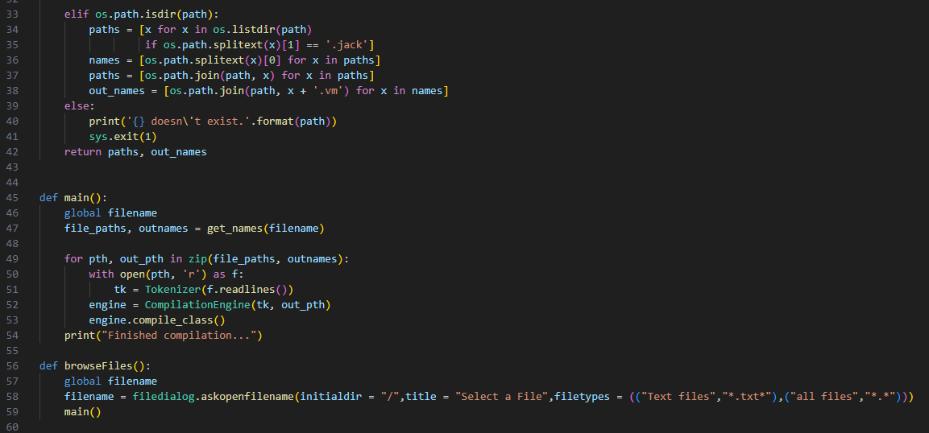
Compile.py

Slide 15
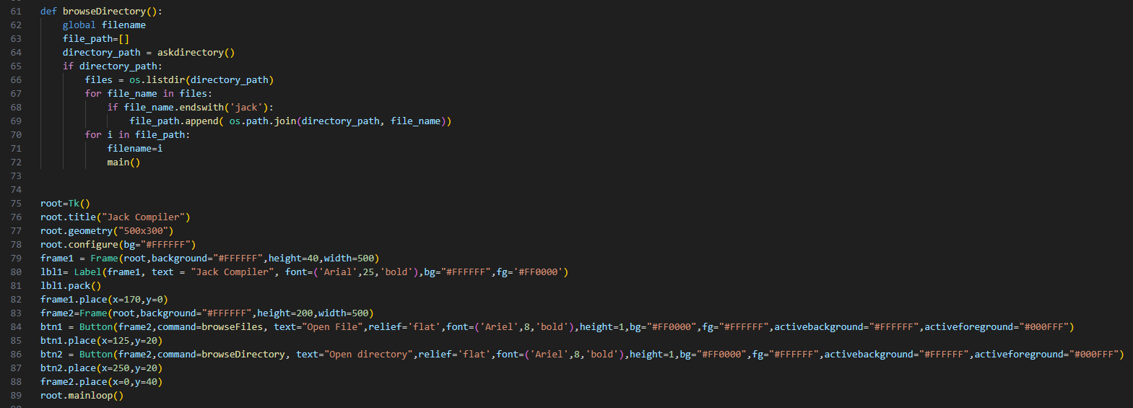
Compile.py (contd)

Slide 16
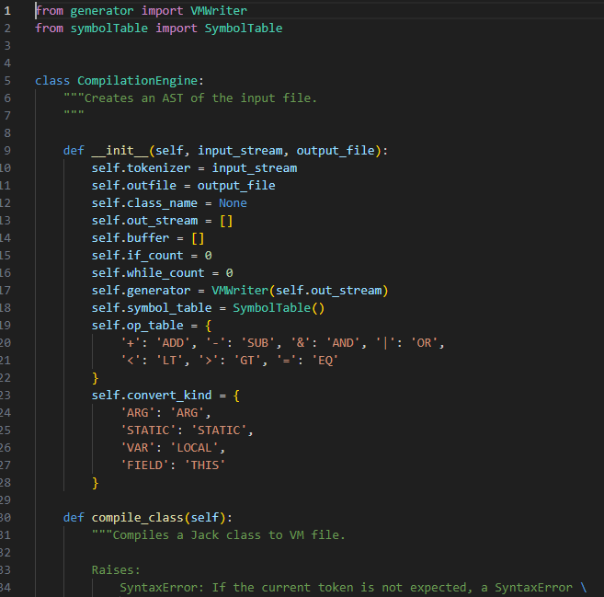
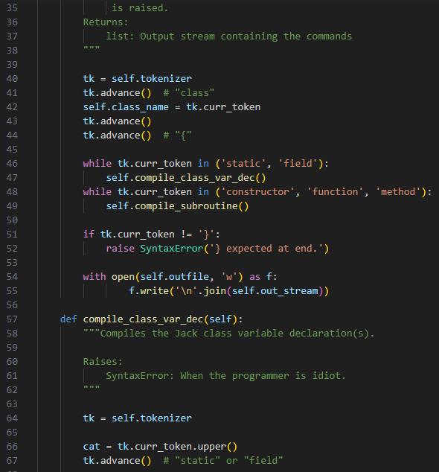
Engine.py (contd)

Slide 17
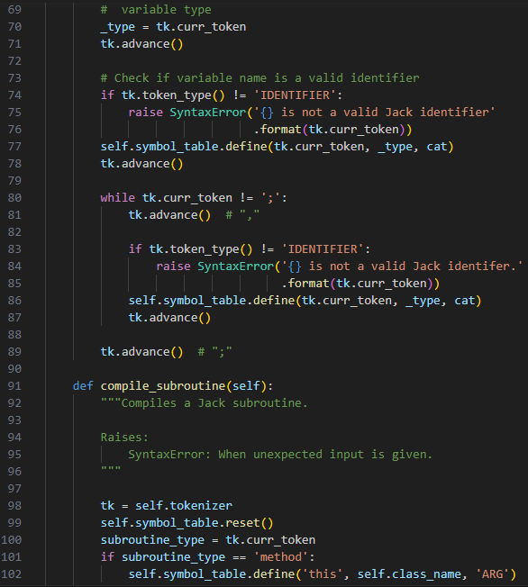
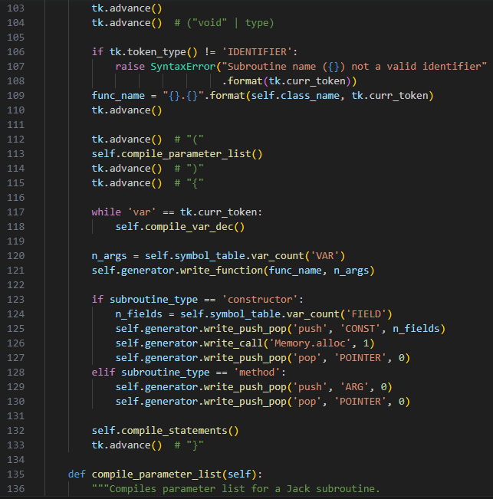
Engine.py (contd)

Slide 18
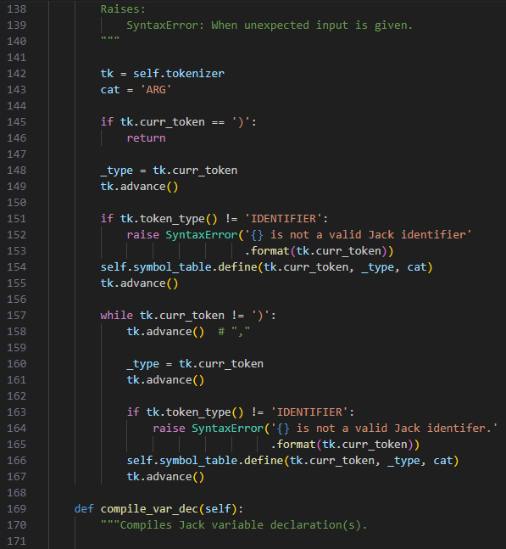
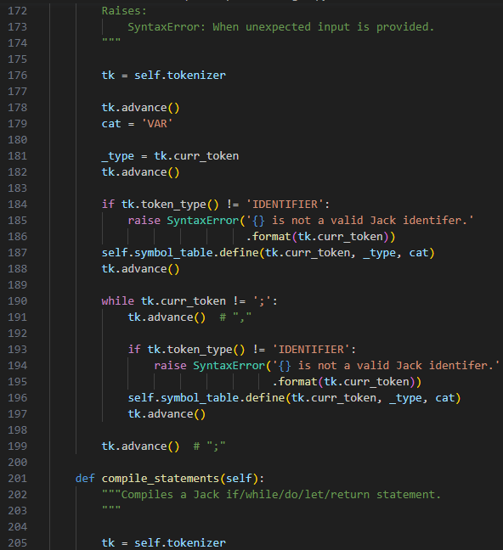
Engine.py (contd)

Slide 19
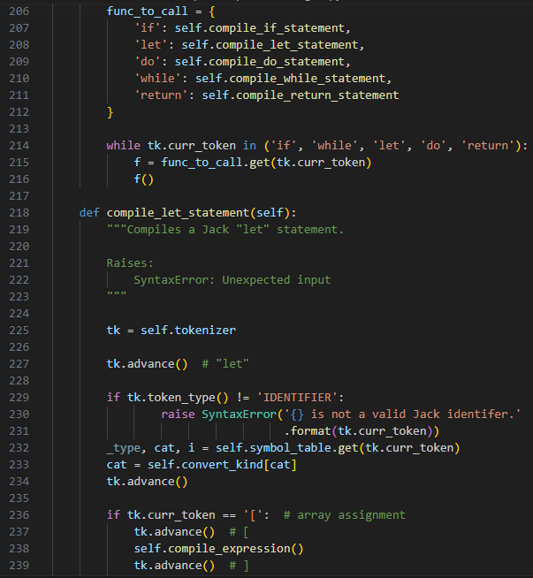
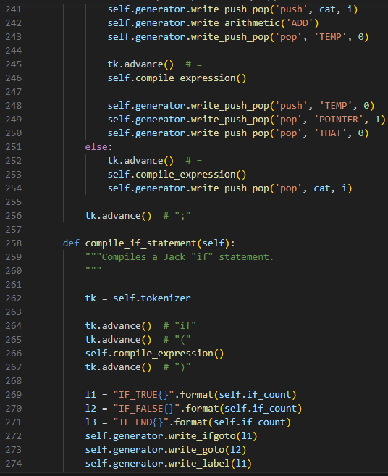
Engine.py (contd)

Slide 20
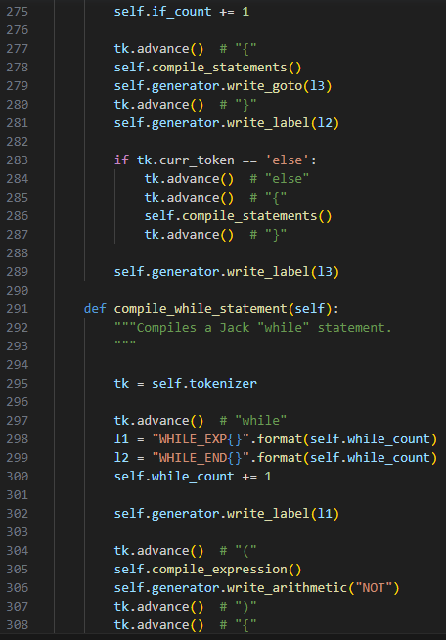
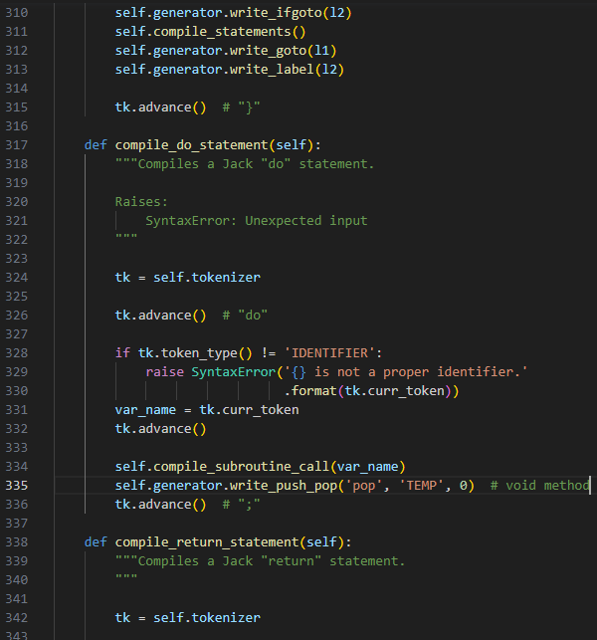
Engine.py (contd)

Slide 21
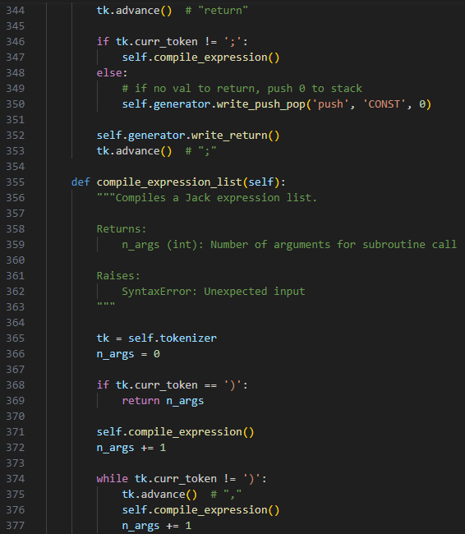
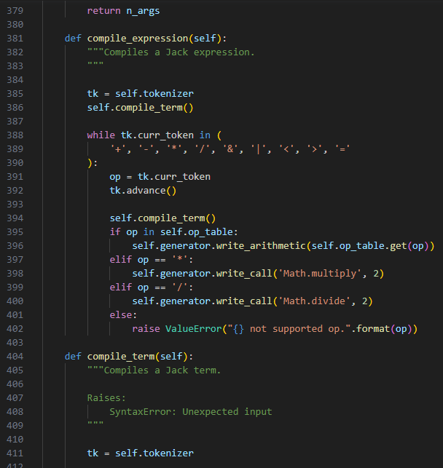
Engine.py (contd)

Slide 22
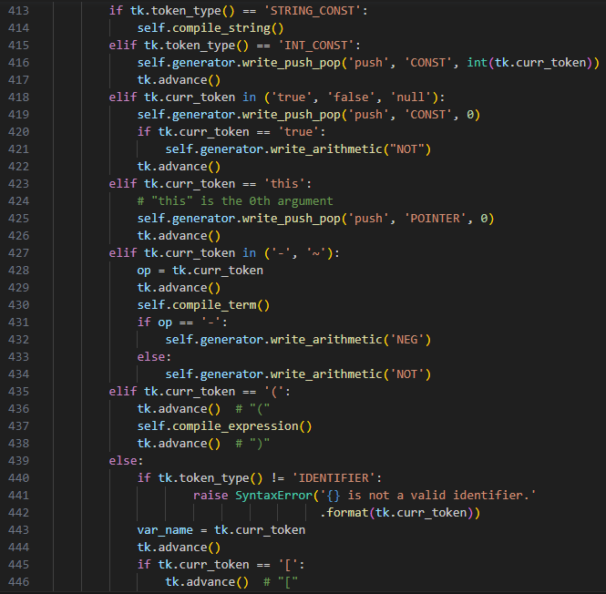
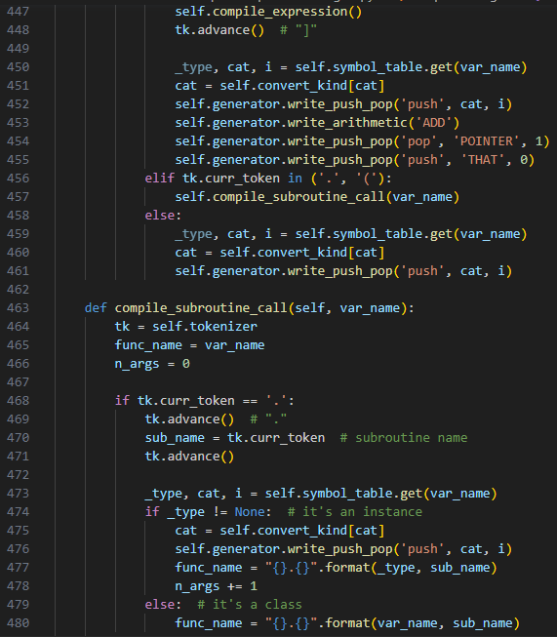
Engine.py (contd)

Slide 23
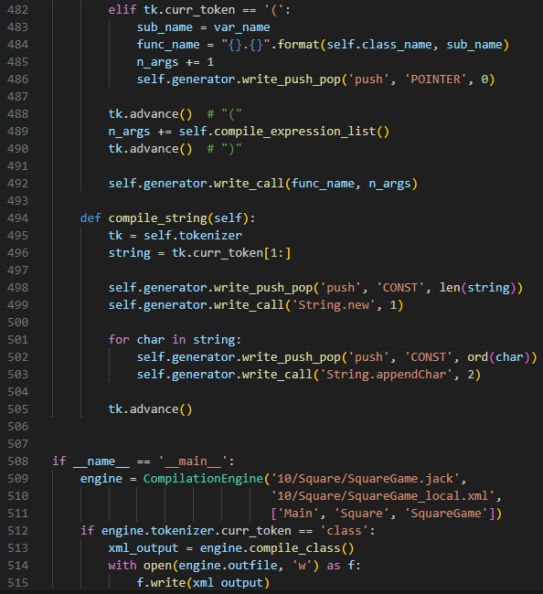

Engine.py (contd)

Slide 24
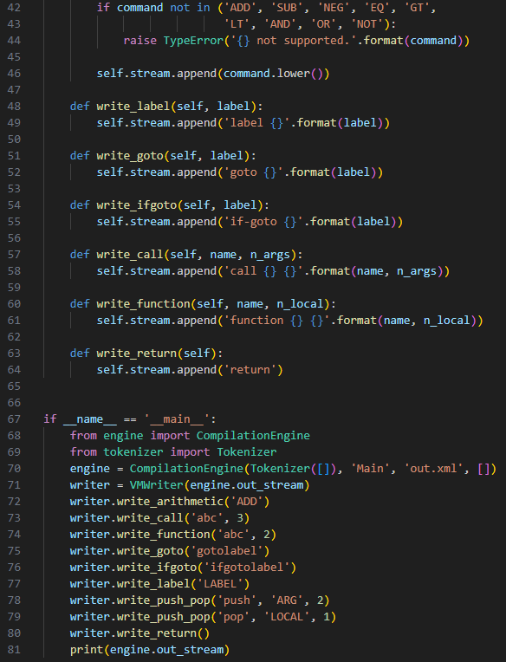
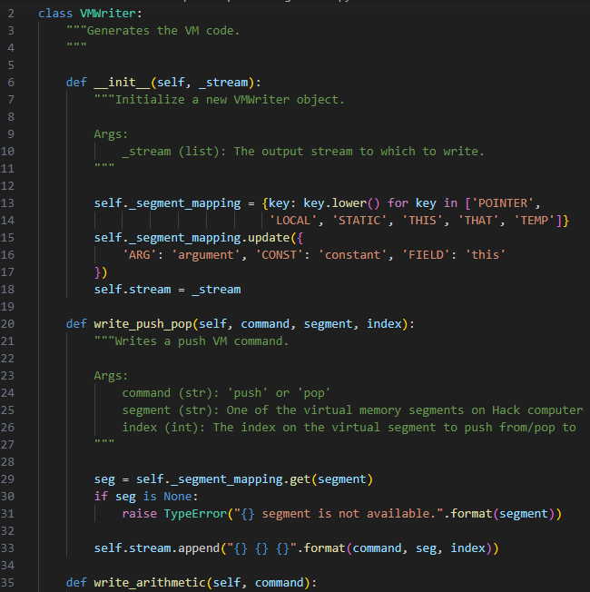
generator.py

Slide 25
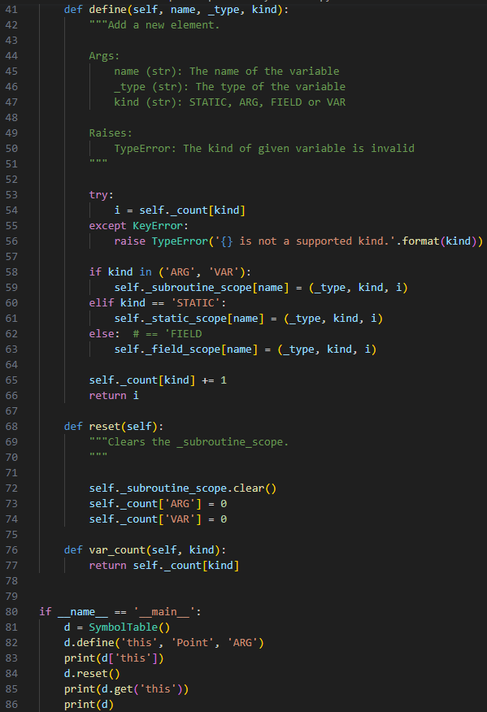
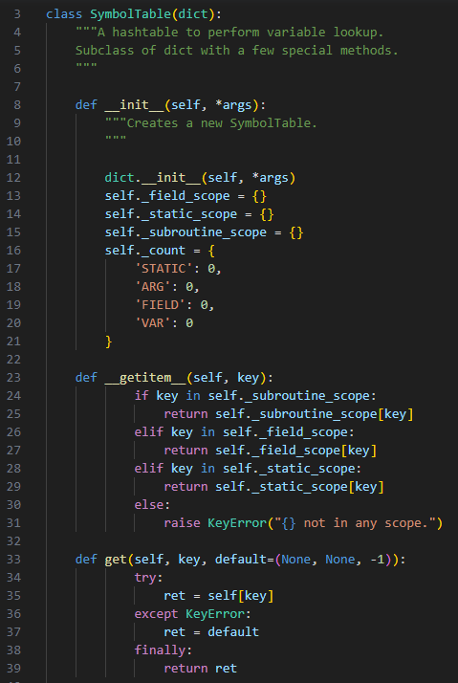
Symboltable.py

Slide 26
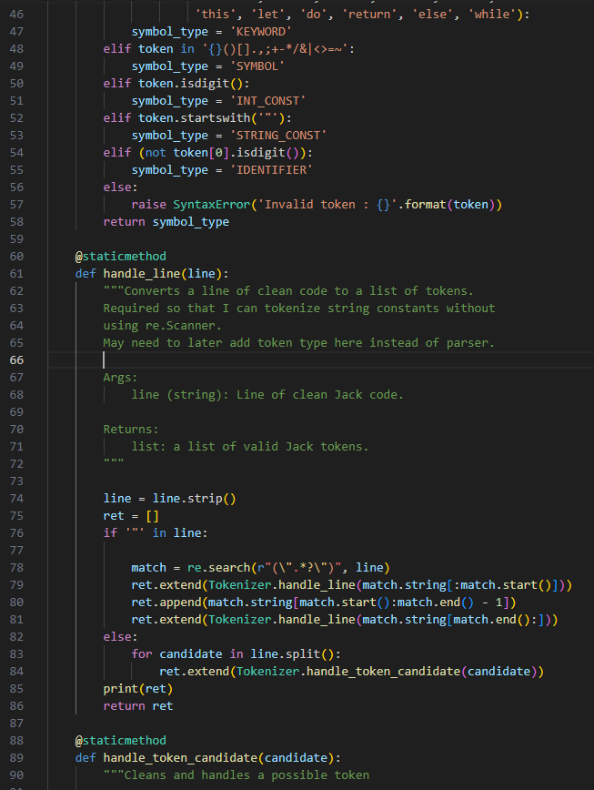
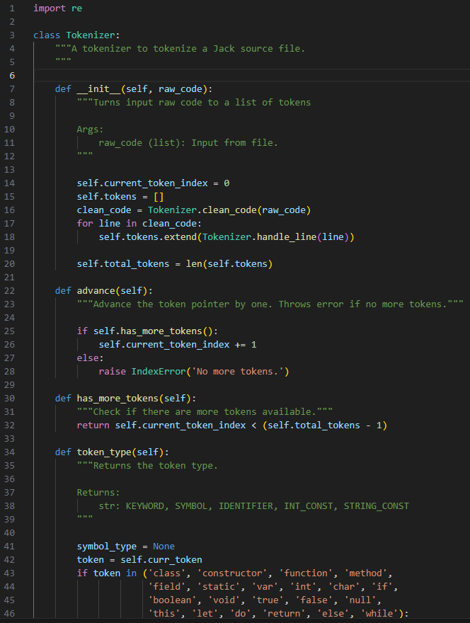
Tokenizer.py

Slide 27
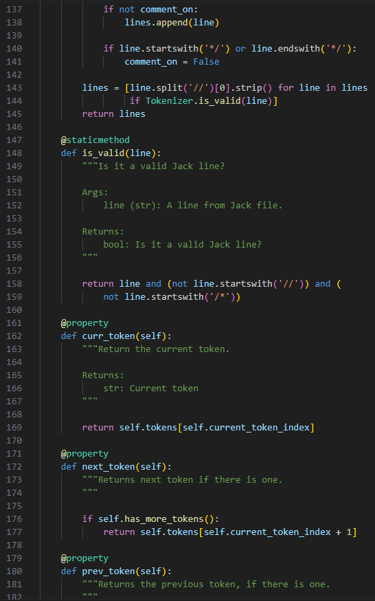
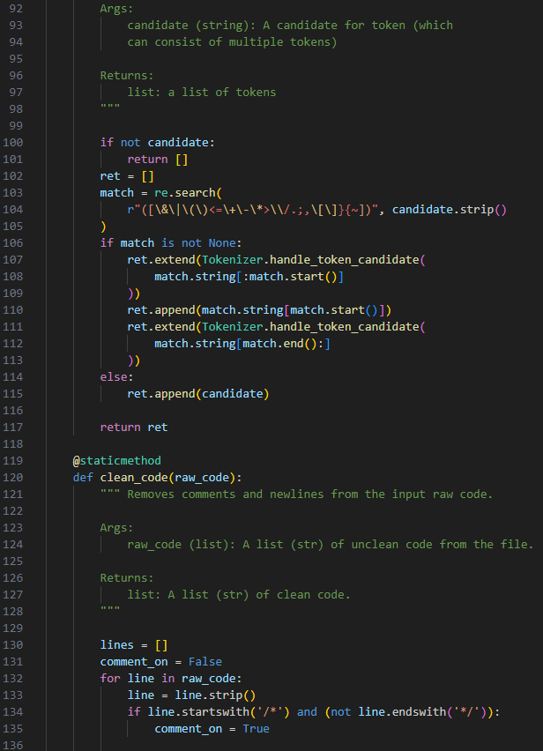
Tokenizer.py (contd)

Slide 28
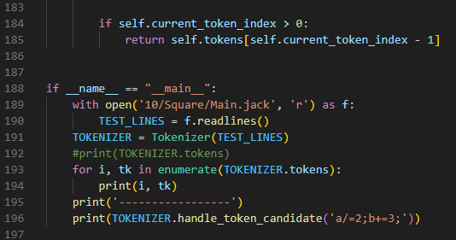
Tokenizer.py (contd)

Slide 29
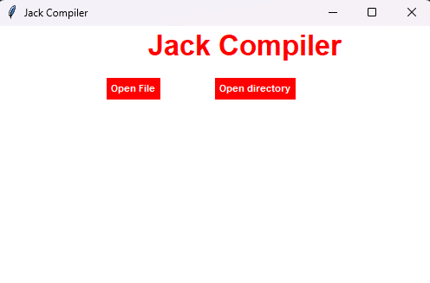
output
When we run the code, this dialog box pops up and we can click on “Open File” and choose our .jack program to compile. After successful compilation, a .vm file with the same name will be created in the same folder as the .jack file.

Slide 30
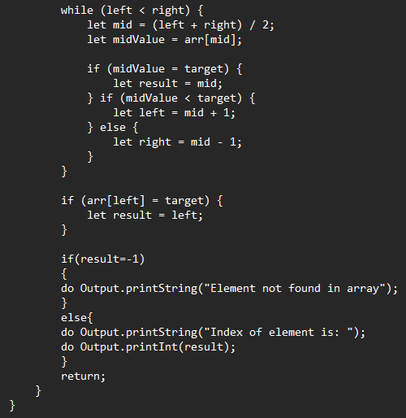
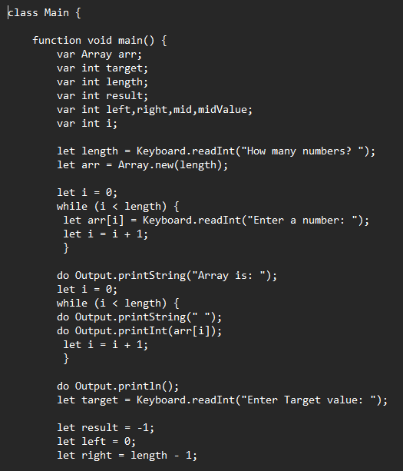
Binarysearch.jack

Slide 31
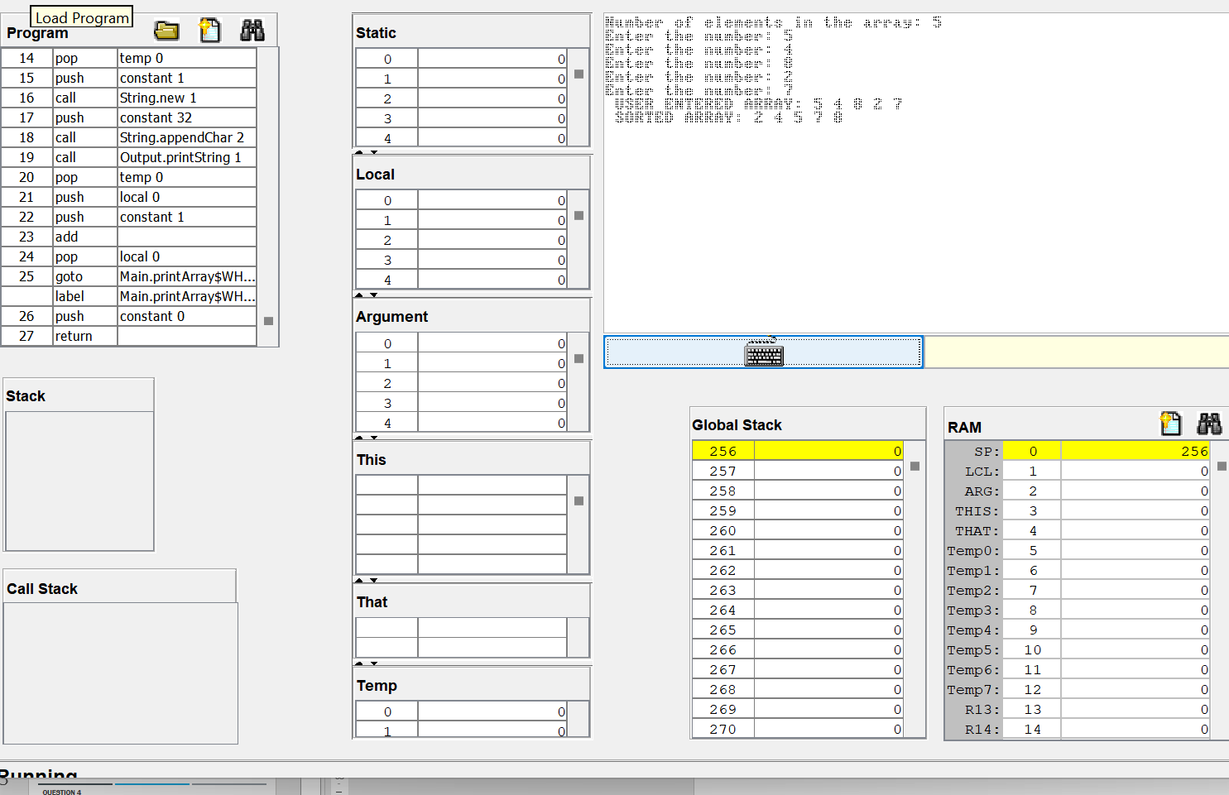
Output in vm emulator after compiling using our compiler

Slide 32
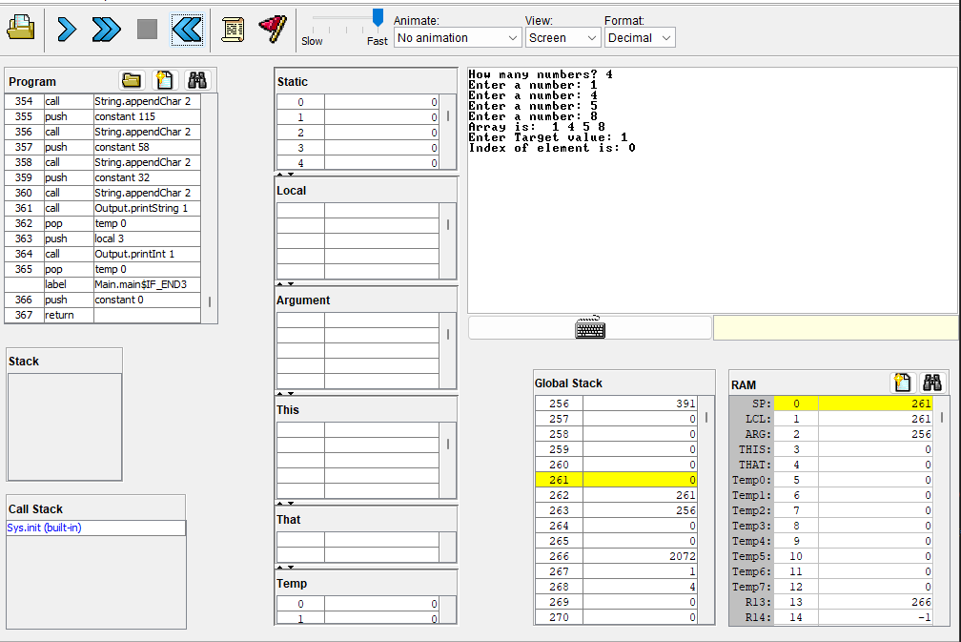
Output in vm emulator after compiling using our compiler

Slide 33
Question 4 Check the correctness of the program ArrayTest in folder 12 of projects using the inbuilt Jack Compiler and supplied test script. Use your VM translator to translate the above .jack program to .vm program. Execute the generated .asm programs on the VM emulator using the supplied test script.

Slide 34
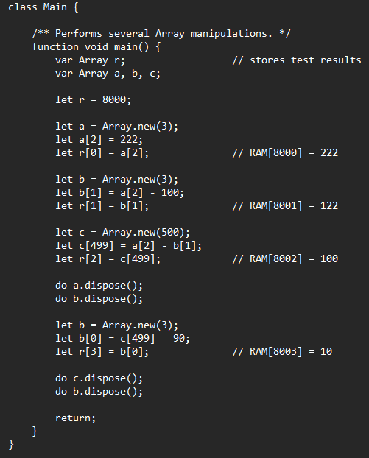
Arraytest.jack

Slide 35
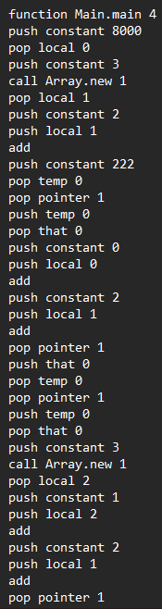
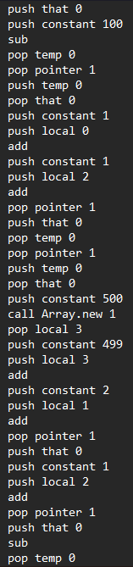
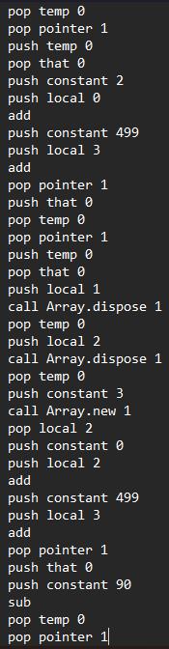
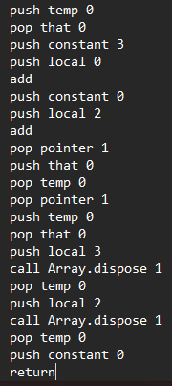
Arraytest.vm (using inbuilt compiler)

Slide 36
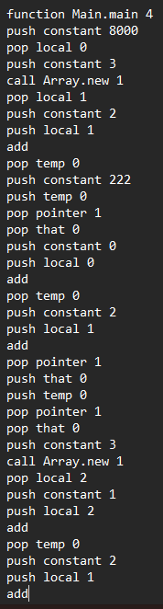
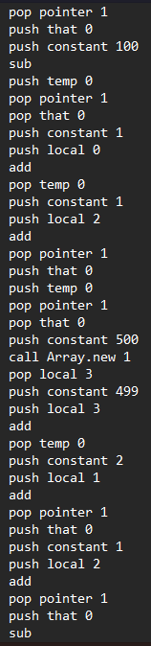
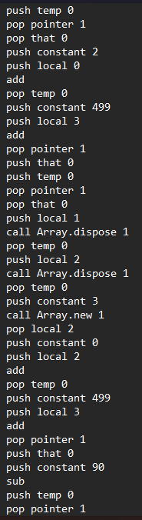
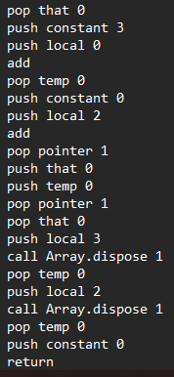
Arraytest.vm (using our compiler)

Slide 37
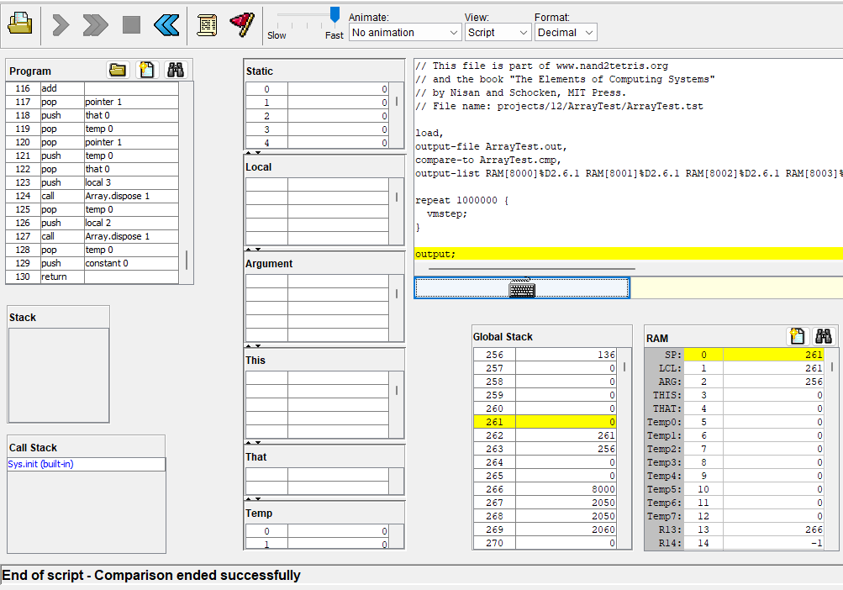
Checking correctness in vm emulator using test script
This is after compiling using inbuilt JackCompiler. As we can see the comparison ended successfully meaning the program is correct

Slide 38
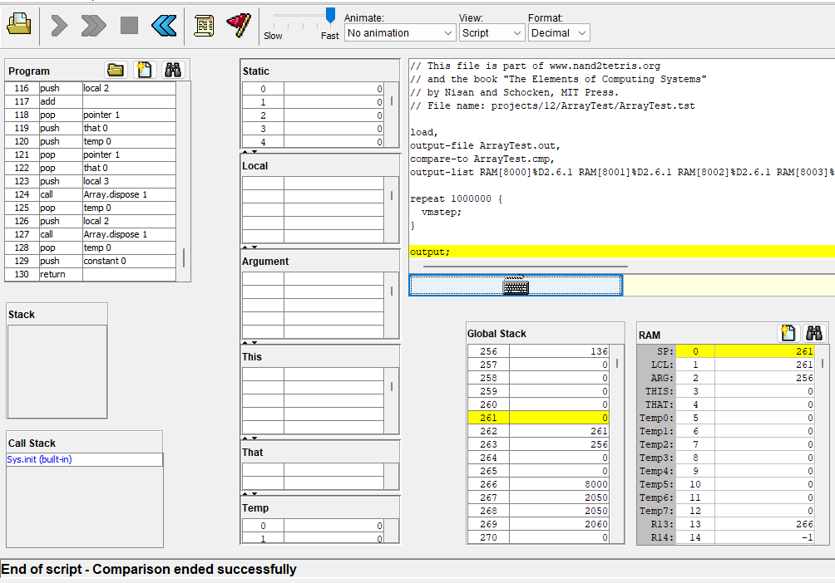
Checking correctness in vm emulator using test script
This is after compiling using our compiler. As we can see the comparison ended successfully meaning the program is correct and thus the compiler we built is working.

Slide 39
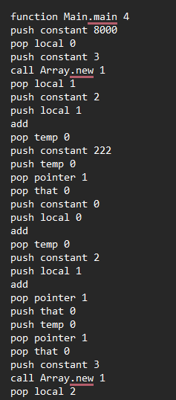



Use your VM translator to translate the above .jack program to .vm program.

Slide 40

Execute the generated .asm programs on the VM emulator using the supplied test script.

Slide 41
CONTRIBUTION
YESHWANTH – Q3, Q4(b), Q4(c)
ASWIN -- Q2,Q4(a)
KISHOR – Q1
SARVESH – MEDICAL LEAVE

